Slide 1

Vehicle Recognition using Single-Shot Detection for Autonomous Implementation.
CSC 7991: Intro to Deep Learning
Group 2
Jamal Warida
Mustafa Ahmed
Kyle W. Brown
Sujeet Shrestha
Wayne State University
May 15, 2019

Slide 2
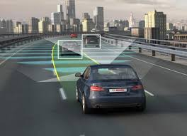
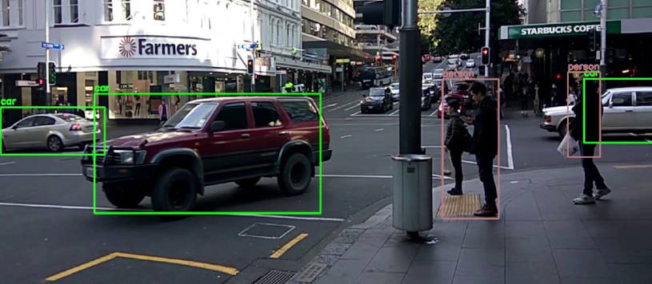

Overview
Single-Shot Detection (SSD)
Model
Training
Experiments
Related Work
Developing Applications
Conclusion
Objective: Identify vehicles in nighttime, snowy, and drone YouTube videos using SSD’s bounding boxes for vehicle recognition.

Slide 3
Introduction
Current state-of-the-art object detection systems are variants of the following approach:
Hypothesize bounding boxes
Resample pixels or features for each box
Applying a high-quality classifier
Approaches are computationally intensive for embedded systems.
Too slow for real-time applications.

Slide 4
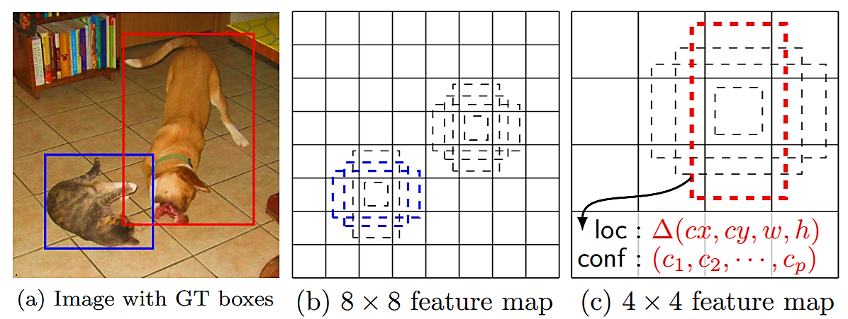
Single Shot Detection (SSD)
SSD, is a single-shot detector for multiple categories that is faster than the previous state-of-the-art for single shot detectors (YOLO).
The core of SSD is predicting category scores and box offsets for a fixed set of default bounding boxes using small convolutional filters applied to feature maps.
To achieve high detection accuracy, predictions of different scales are produced from feature maps of different scales, then predictions are separated by aspect ratio.

Slide 5
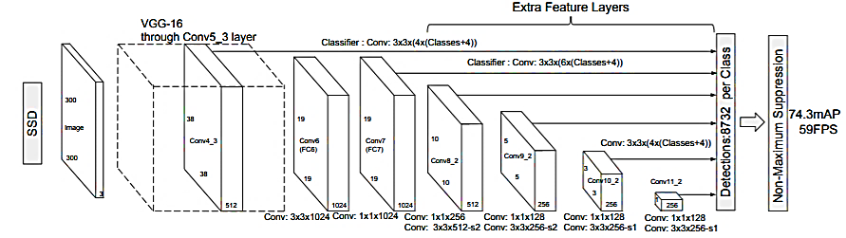
Model
Multi-scale feature maps
Convolutional feature layers are added to the end of the network which decrease in size and allow predictions of detections at multiple scales
Convolutional predictors
Bounding box offset output values are measured relative to a default box position relative to each feature map location.
Default Boxes and aspect Ratios

Slide 6
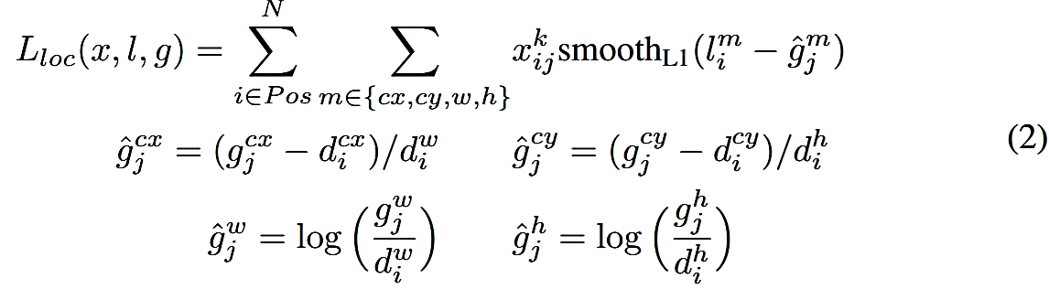
Training
The overall objective loss function is a weighted sum of the localization loss (loc) and the confidence loss (conf):
The overall objective loss function is a weighted sum of the localization loss (loc) and the confidence loss (conf):
where N is the number of matched default boxes. If N = 0, wet set the loss to 0. The localization loss is a Smooth L1 loss between the predicted box (l) and the ground truth box (g) parameters.

Slide 7
Training
The confidence loss is the softmax loss over multiple classes confidences (c).
Suppose we want to use m feature maps for prediction. The scale of the default boxes for each feature map is computed as:
where S_{min} is 0.2 and S_{max} is 0.9, meaning the lowest layer has a scale of 0.2 and the highest layer has a scale of 0.9, and all layers in between are regularly spaced.

Slide 8
Experiments
Bounding boxes to identify vehicles from YouTube videos.
Experiments designed to test vehicle recognition using SSD to identify vehicles.
Experiments include:
Identifying moving and parked vehicles in snowy conditions.
Using bounding boxes to identify vehicles in night time video.
Drone videos of vehicles moving and parked.

Slide 9


Snowy Experiments
Parked Vehicles
Moving Vehicles
Distance | Total Vehicles | Identified Vehicles | Accuracy
< 10 ft | 25 | 4 | 16%
Distance | Total Vehicles | Identified Vehicles | Accuracy
< 5 ft | 9 | 4 | 44 %

Slide 10
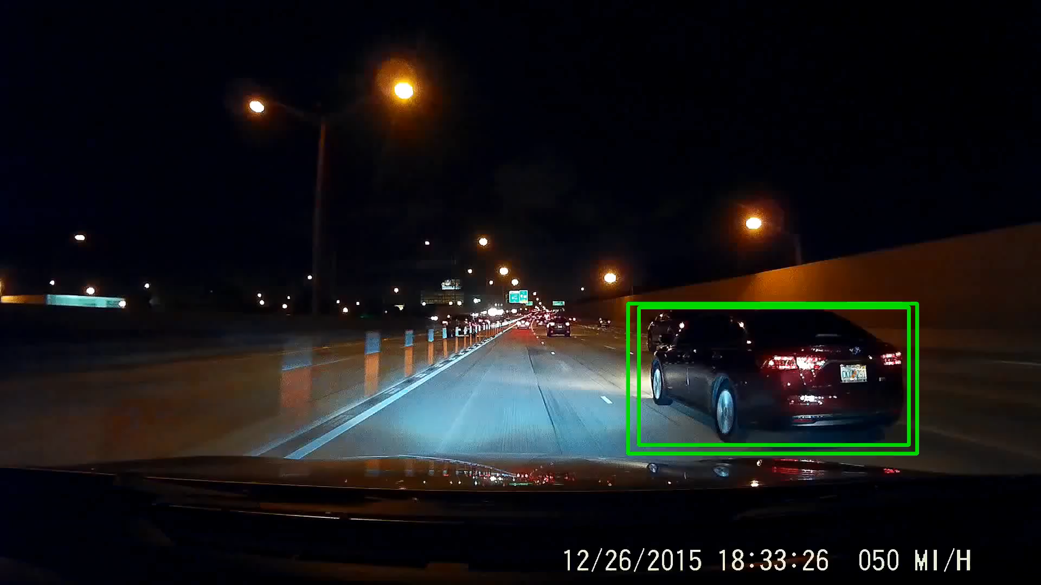
Night Time Experiment
Moving Vehicles
Distance | Total Vehicles | Identified Vehicles | Accuracy
< 10 ft | 14 | 6 | 43 %

Slide 11
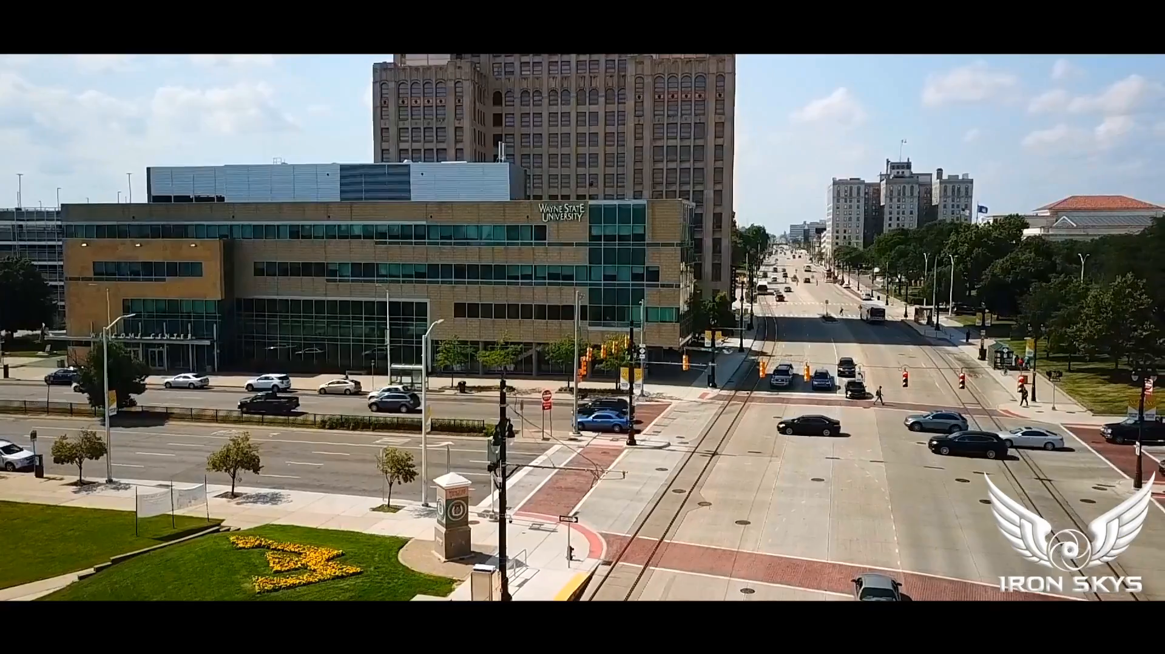
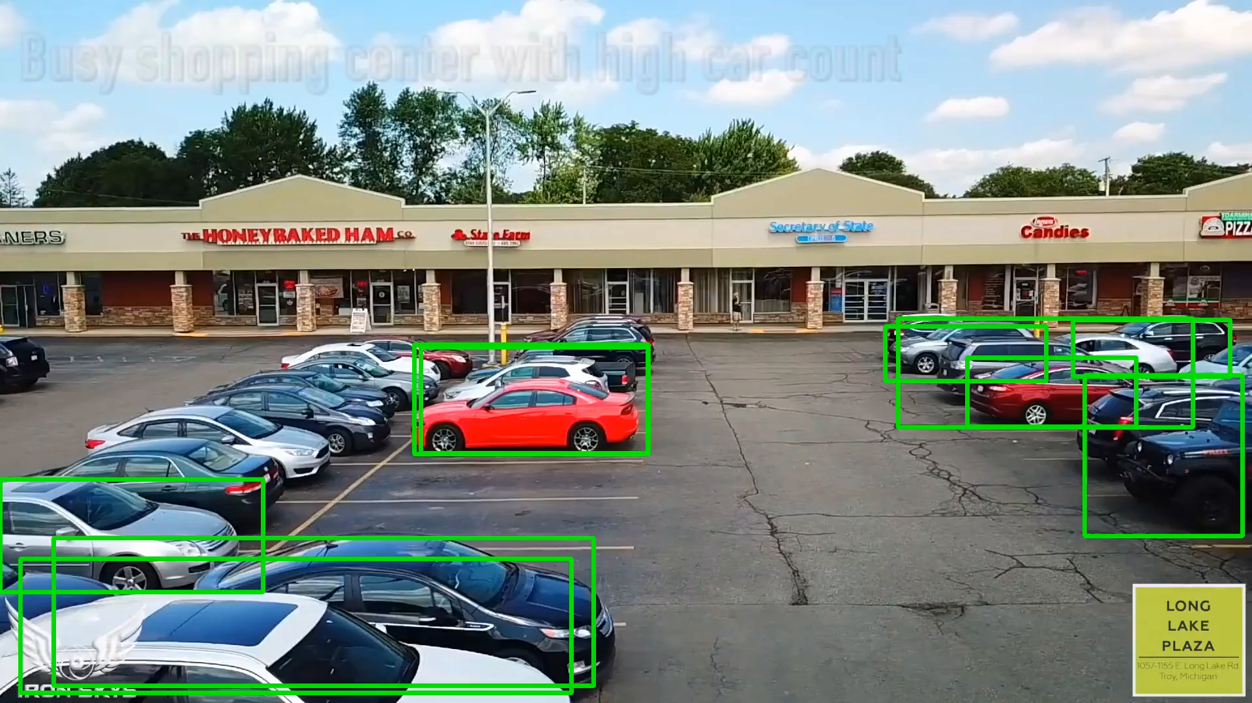
Drone Experiments
Moving Vehicles
Parked Vehicles
Distance | Total Vehicles | Identified Vehicles | Accuracy
> 50 ft | 17 | 3 | 18 %
Distance | Total Vehicles | Identified Vehicles | Accuracy
< 15 ft | 28 | 23 | 82 %

Slide 12
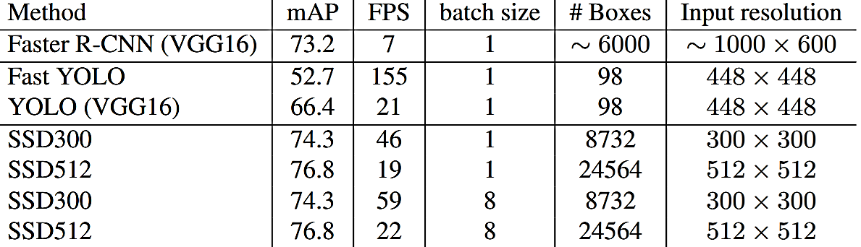
Related Work
SSD300 is the only real-time detection method that can achieve above 70% mAP.
When using a larger input image, SSD512 outperforms all methods on accuracy while maintaining a near real-time speed.

Slide 13
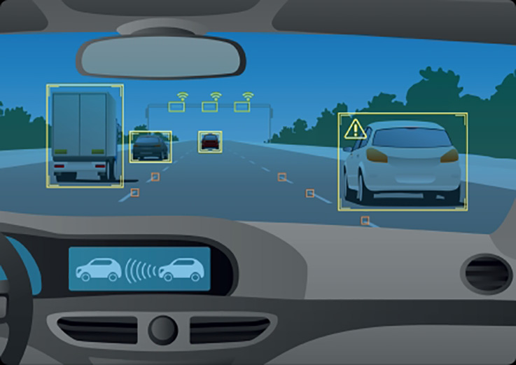
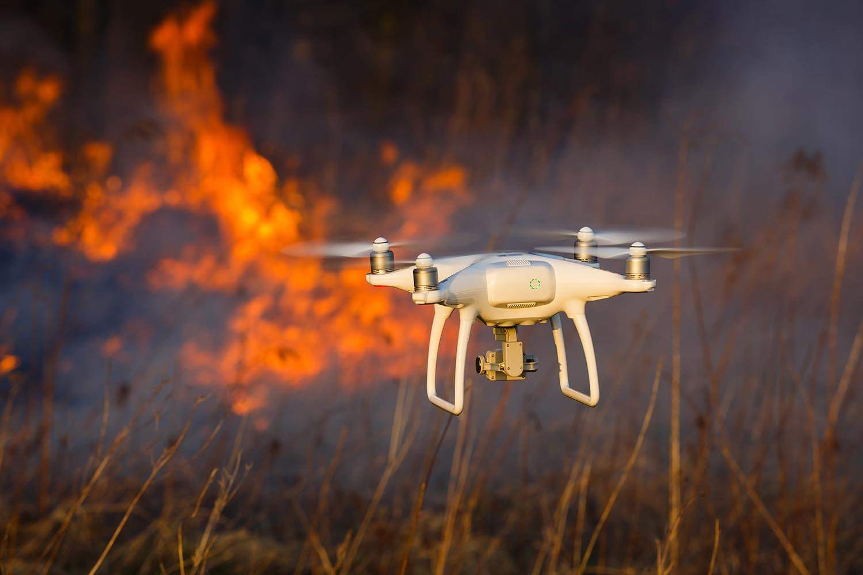
Developing Applications
Autonomous
ADAS
Military
Transportation
Bomb disposal
Drones
Emergency & Rescue
Object detection & tracking

Slide 14
Conclusion
Discussed SSD, a fast-single shot detector for multiple categories.
Introduced state-of-the-art related work using SSD for vehicle recognition using YouTube videos.
Experiments
Snowy conditions:
Nighttime conditions:
Drone videos
New and developing technology with many potential military, rescue, and autonomous applications.
Experiment | Accuracy
Snowy -Parked | 16%
Snowy - Moving | 44%
Nighttime | 43%
Drone - Moving | 18%
Drone - Parked | 82%

Slide 15
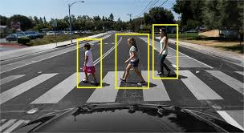
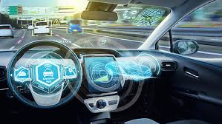
Any Questions or Comments?

